Slide 1



Lab 11
CNN MNIST
With PyTorch 0.2.0_2
Sung Kim <hunkim+ml@gmail.com>
Code: https://github.com/hunkim/DeepLearningZeroToAll/

Slide 2
Lab 11-1
CNN Basics
With PyTorch 0.2.0_2
Sung Kim <hunkim+ml@gmail.com>
Code: https://github.com/hunkim/DeepLearningZeroToAll/

Slide 3
https://github.com/hunkim/DeepLearningZeroToAll/tree/master/pytorch
https://github.com/hunkim/DeepLearningZeroToAll/blob/master/pytorch/lab-11-1-mnist_cnn.py

Slide 4
CNN
http://parse.ele.tue.nl/cluster/2/CNNArchitecture.jpg

Slide 5
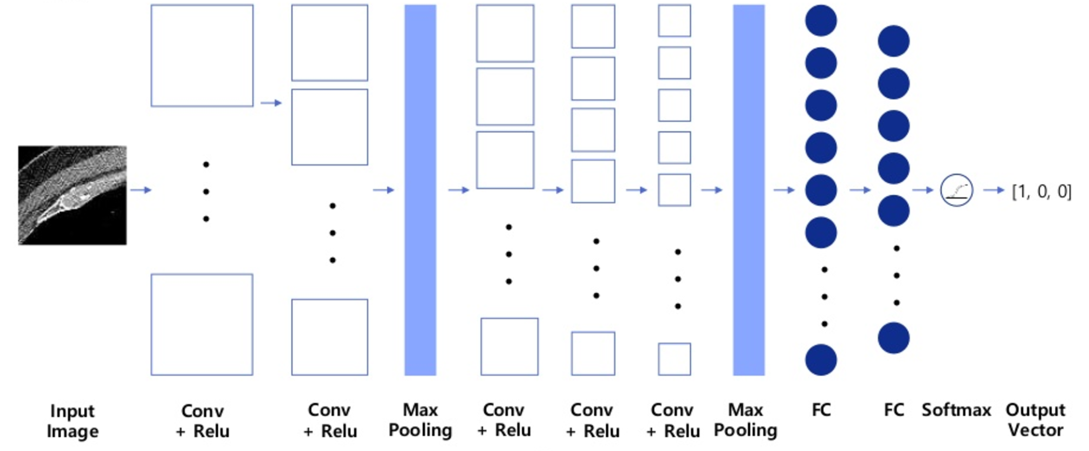
CNN for CT images
Asan Medical Center & Microsoft Medical Bigdata Contest Winner by GeunYoung Lee and Alex Kim
https://www.slideshare.net/GYLee3/ss-72966495

Slide 6
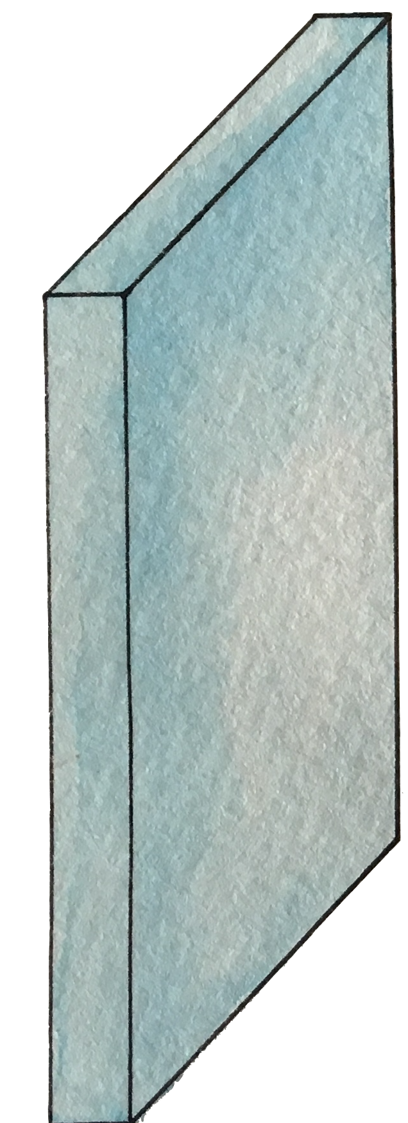
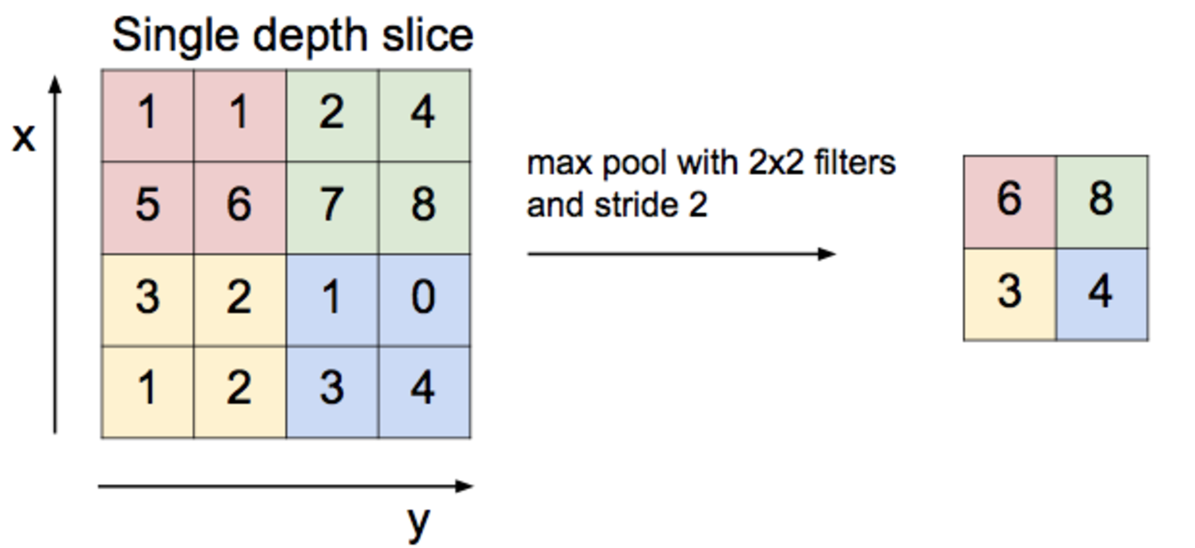
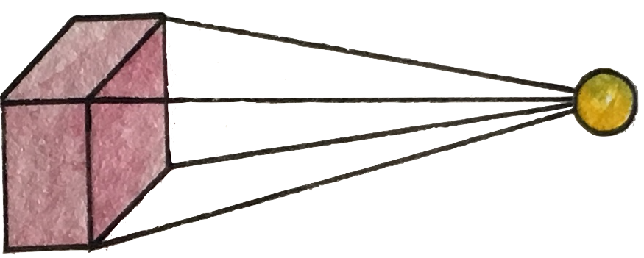
Convolution layer and max pooling

Slide 7
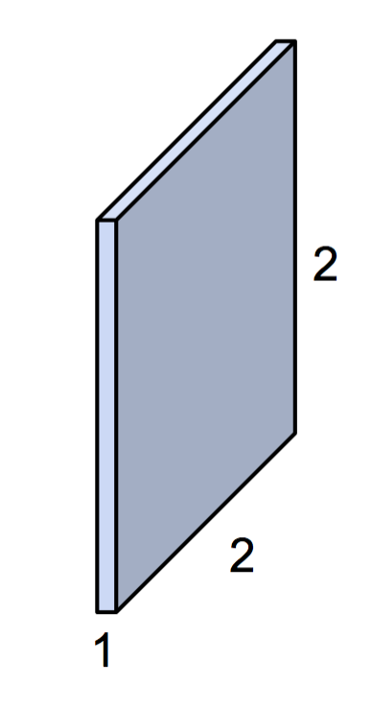
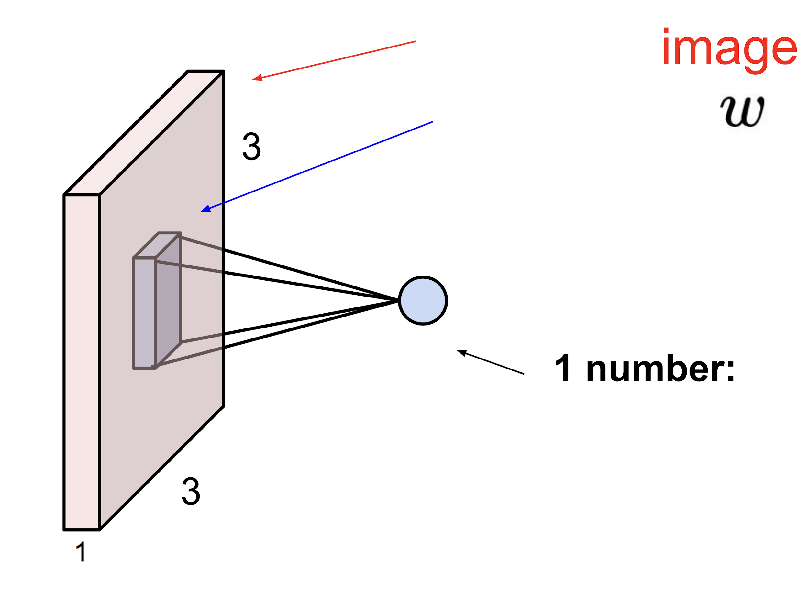
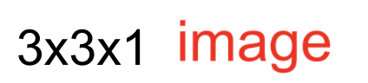
Simple convolution layer
Stride: 1x1
3x3x1
2x2x1 filter

Slide 8
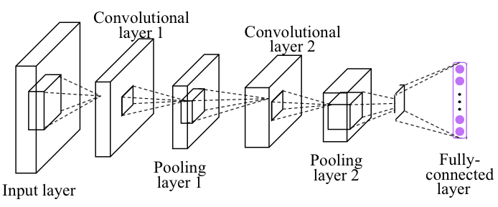
Simple CNN

Slide 9
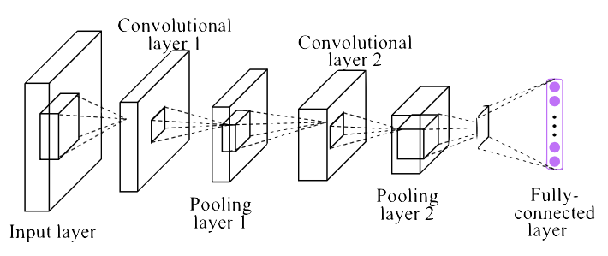
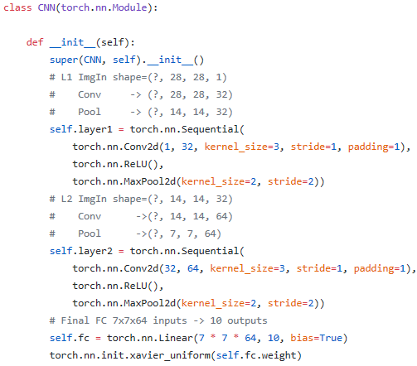
Conv layer 1
https://github.com/hunkim/DeepLearningZeroToAll/blob/master/pytorch/lab-11-1-mnist_cnn.py

Slide 10
Conv layer 2
https://github.com/hunkim/DeepLearningZeroToAll/blob/master/pytorch/lab-11-1-mnist_cnn.py

Slide 11
Fully Connected (FC, Dense) layer
https://github.com/hunkim/DeepLearningZeroToAll/blob/master/pytorch/lab-11-1-mnist_cnn.py

Slide 12
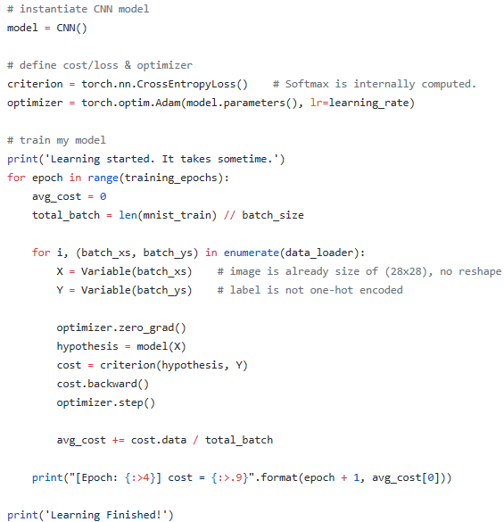
Training and Evaluation
https://github.com/hunkim/DeepLearningZeroToAll/blob/master/pytorch/lab-11-1-mnist_cnn.py

Slide 13
Training and Evaluation
Epoch: 0001 cost = 0.340291267
Epoch: 0002 cost = 0.090731326
Epoch: 0003 cost = 0.064477619
Epoch: 0004 cost = 0.050683064
...
Epoch: 0011 cost = 0.017758641
Epoch: 0012 cost = 0.014156652
Epoch: 0013 cost = 0.012397016
Epoch: 0014 cost = 0.010693789
Epoch: 0015 cost = 0.009469977
Learning Finished!
Accuracy: 0.9885
https://github.com/hunkim/DeepLearningZeroToAll/blob/master/pytorch/lab-11-1-mnist_cnn.py

Slide 14
Lab 11-2
Deep CNN
With PyTorch 0.2.0_2
Sung Kim <hunkim+ml@gmail.com>
Code: https://github.com/hunkim/DeepLearningZeroToAll/

Slide 15
https://github.com/hunkim/DeepLearningZeroToAll/tree/master/pytorch
https://github.com/hunkim/DeepLearningZeroToAll/blob/master/pytorch/lab-11-2-mnist_deep_cnn.py

Slide 16
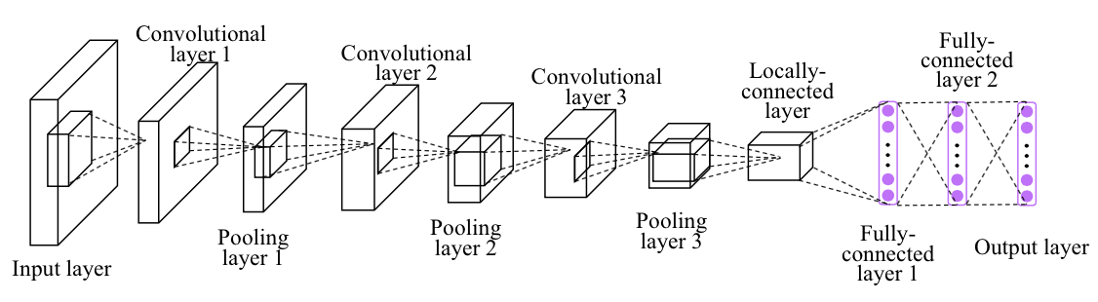
Deep CNN
Image credit: http://personal.ie.cuhk.edu.hk/~ccloy/project_target_code/index.html

Slide 17
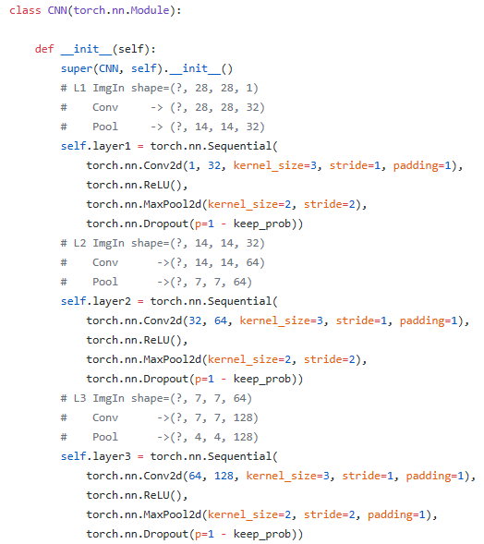
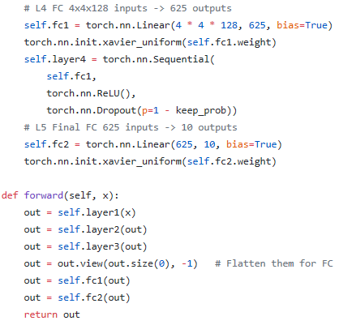
Deep CNN
https://github.com/hunkim/DeepLearningZeroToAll/blob/master/pytorch/lab-11-2-mnist_deep_cnn.py

Slide 18
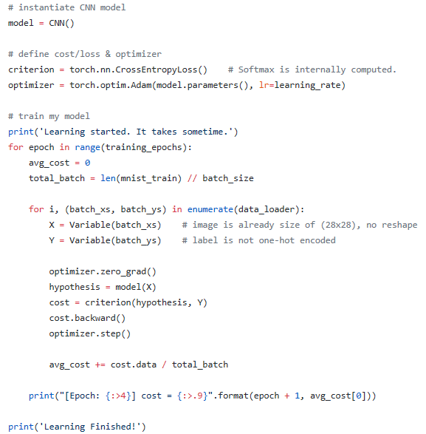
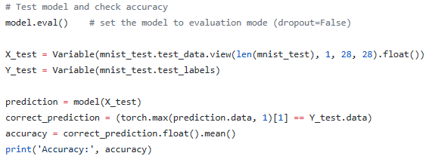
Deep CNN
Epoch: 0013 cost = 0.027188021
Epoch: 0014 cost = 0.023604777
Epoch: 0015 cost = 0.024607201
Learning Finished!
Accuracy: 0.9938
https://github.com/hunkim/DeepLearningZeroToAll/blob/master/pytorch/lab-11-2-mnist_deep_cnn.py

Slide 19
Lab 11-3
CNN Class
With PyTorch 0.2.0_2
Sung Kim <hunkim+ml@gmail.com>
Code: https://github.com/hunkim/DeepLearningZeroToAll/

Slide 20
https://github.com/hunkim/DeepLearningZeroToAll/tree/master/pytorch
https://github.com/hunkim/DeepLearningZeroToAll/blob/master/pytorch/lab-11-3-mnist_cnn_class.py

Slide 21
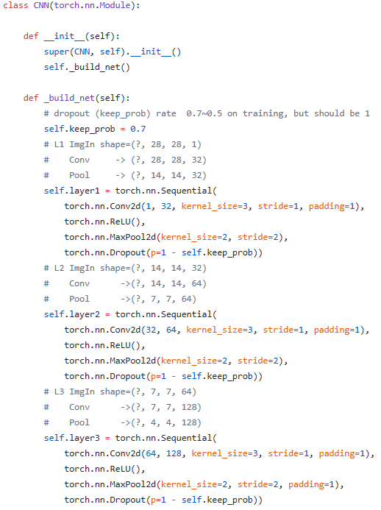
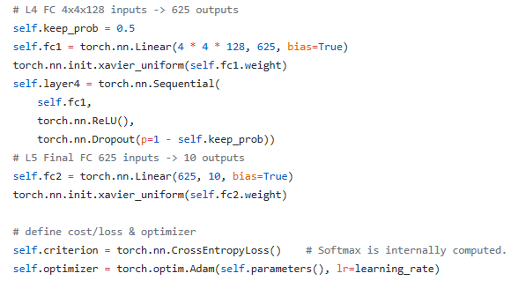
CNN
Python Class
https://github.com/hunkim/DeepLearningZeroToAll/blob/master/pytorch/lab-11-3-mnist_cnn_class.py

Slide 22
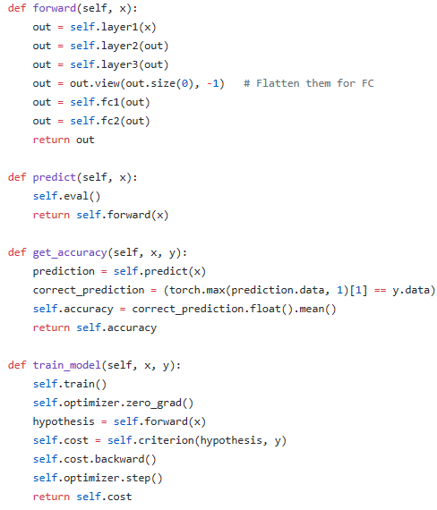
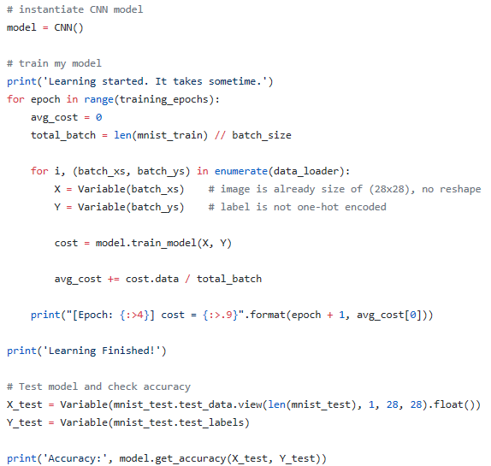
CNN
Python Class
https://github.com/hunkim/DeepLearningZeroToAll/blob/master/pytorch/lab-11-3-mnist_cnn_class.py

Slide 23
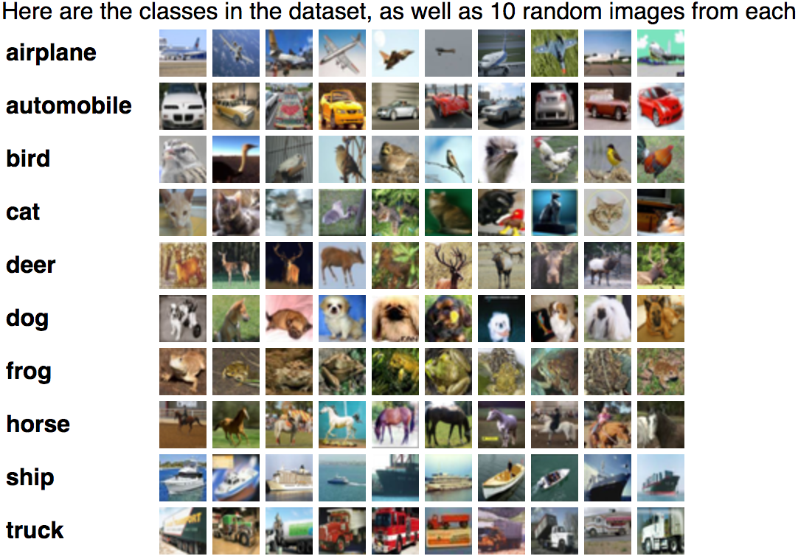
Exercise
Deep & Wide?
CIFAR 10
ImageNet

Slide 24
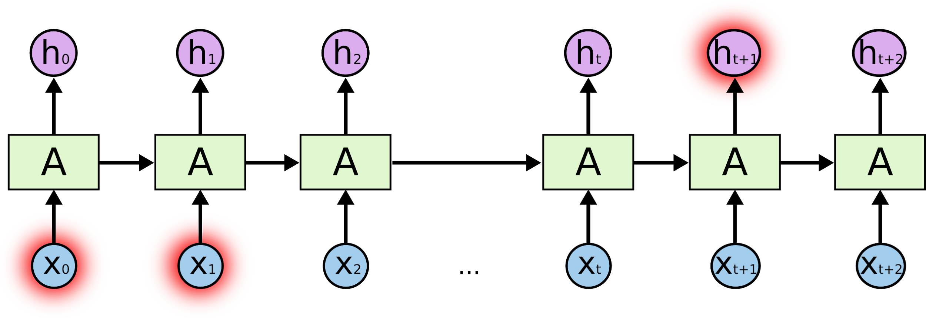
Lab 12
RNN
With PyTorch 0.2.0_2
Sung Kim <hunkim+ml@gmail.com>
http://hunkim.github.io/ml/

